Slide 1
Automated Intracranial Artery Labeling using a Graph Neural Network and Hierarchical Refinement

Slide 2
Graph neural network (GNN) for node and edge probabilities
Automated Intracranial Artery Labeling using a Graph Neural Network and Hierarchical Refinement

Slide 3
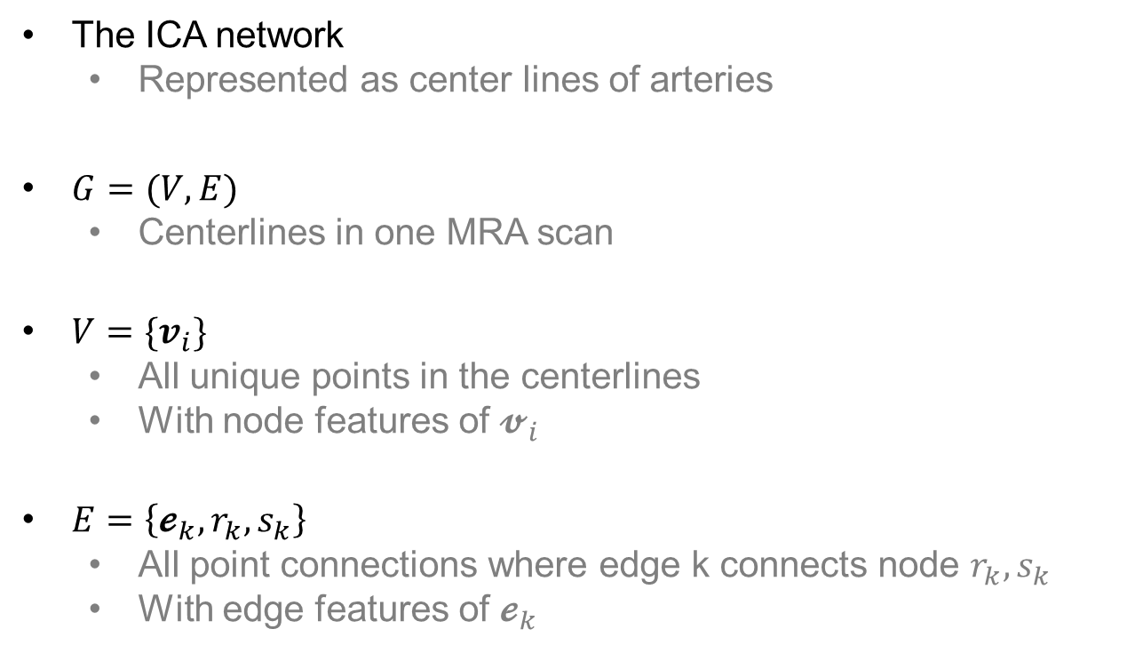
Automated Intracranial Artery Labeling using a Graph Neural Network and Hierarchical Refinement
Graph neural network (GNN) for node and edge probabilities
The ICA network
Represented as center lines of arteries
$G=(V, E)$
Centerlines in one MRA scan
$V=\{v_{i}\}$
All unique points in the centerlines
With node features of $𝓿_{i}$
$E=\left\{𝓮_{k}, r_{k}, s_{k}\right\}$
All point connections where edge k connects node $r_{k}, s_{k}$
With edge features of $𝓮_{k}$

Slide 4
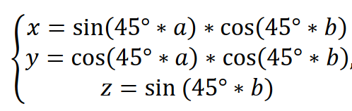
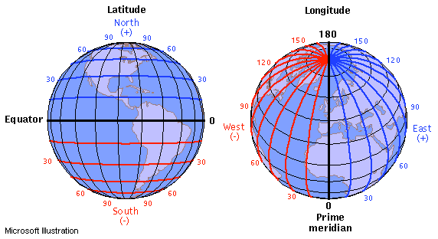
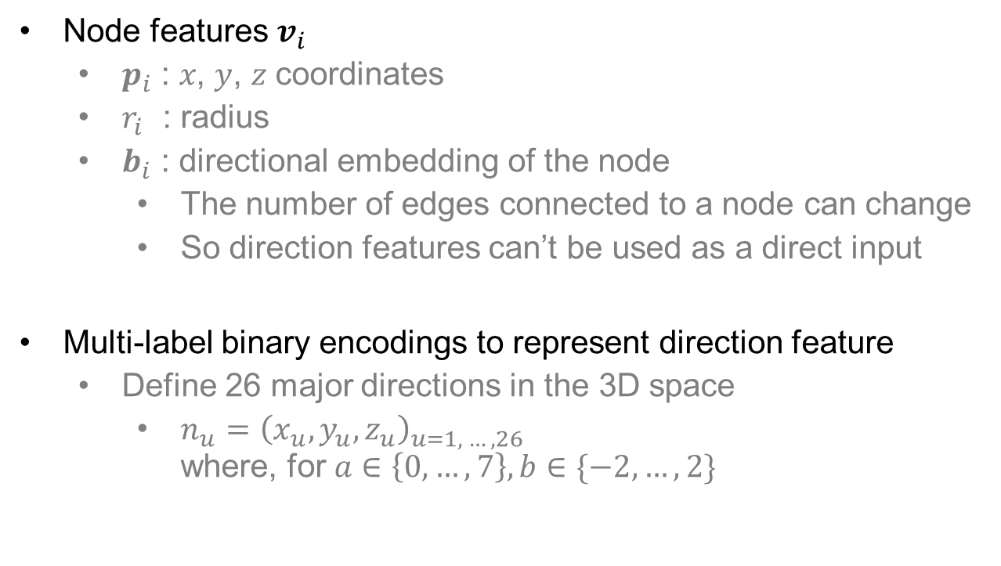
Automated Intracranial Artery Labeling using a Graph Neural Network and Hierarchical Refinement
Graph neural network (GNN) for node and edge probabilities
Node features $v_{i}$
$p_{i}$ : 𝑥, 𝑦, 𝑧 coordinates
$r_{i}$ : radius
$b_{i}$ : directional embedding of the node
The number of edges connected to a node can change
So direction features can’t be used as a direct input
Multi-label binary encodings to represent direction feature
Define 26 major directions in the 3D space
$n_{u}={\left(x_{u}, y_{u}, z_{u}\right)}_{u=1, …, 26}$ where, for $a∈\left\{0, …,7\right\},b∈\{−2, …,2\}$

Slide 5

Automated Intracranial Artery Labeling using a Graph Neural Network and Hierarchical Refinement
Graph neural network (GNN) for node and edge probabilities
Edge features $𝓮_{k}$
All point connections where edge k connects node $r_{k}, s_{k}$
With edge features of $𝓮_{k}$

Slide 6
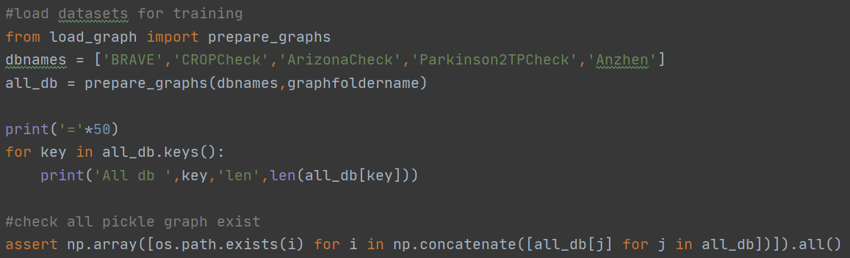
Automated Intracranial Artery Labeling using a Graph Neural Network and Hierarchical Refinement
Graph neural network (GNN) for node and edge probabilities
Load dataset

Slide 7
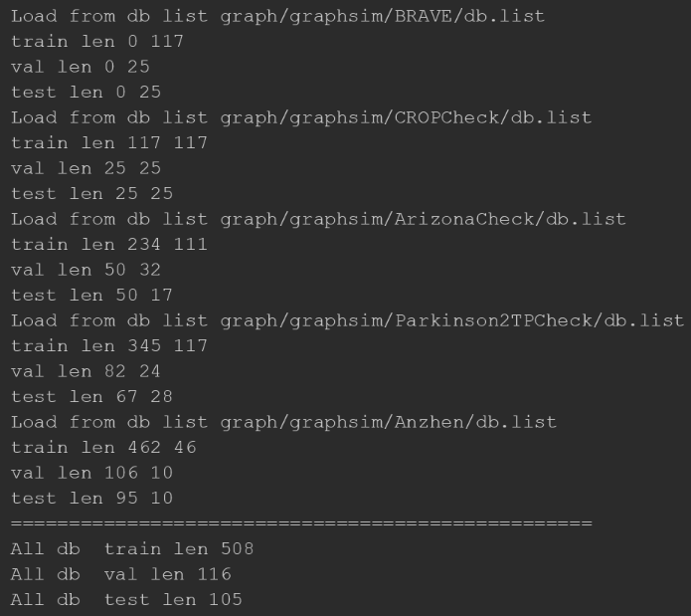
Automated Intracranial Artery Labeling using a Graph Neural Network and Hierarchical Refinement
Graph neural network (GNN) for node and edge probabilities
Load dataset

Slide 8
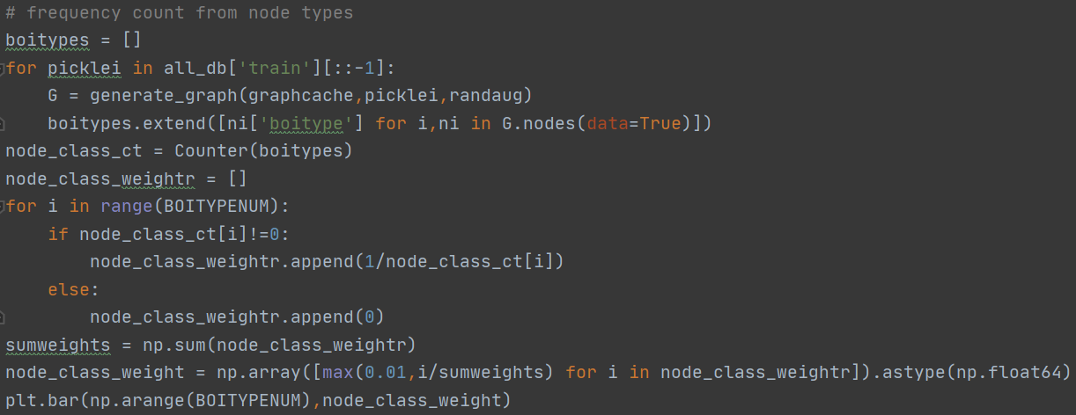
Automated Intracranial Artery Labeling using a Graph Neural Network and Hierarchical Refinement
Graph neural network (GNN) for node and edge probabilities
Frequency count : node

Slide 9
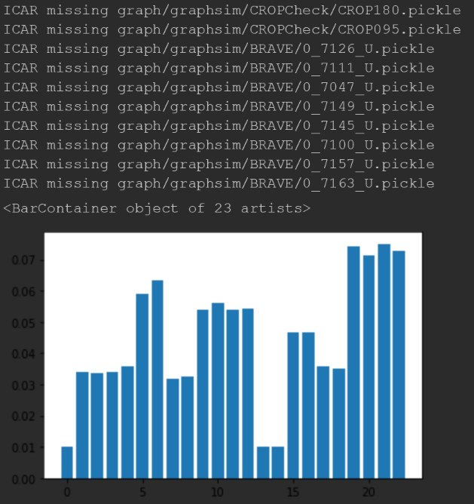
Automated Intracranial Artery Labeling using a Graph Neural Network and Hierarchical Refinement
Graph neural network (GNN) for node and edge probabilities
Frequency count : node

Slide 10
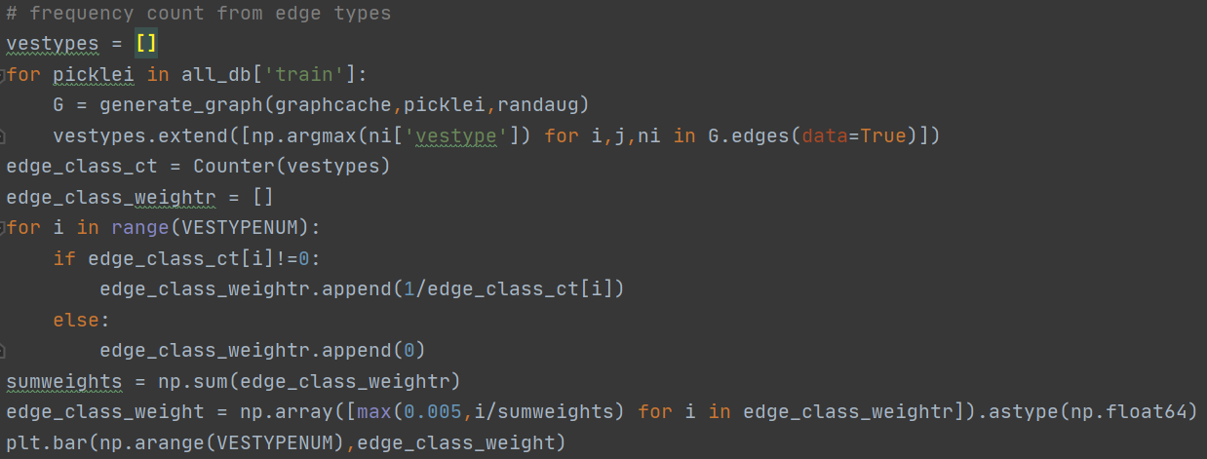
Automated Intracranial Artery Labeling using a Graph Neural Network and Hierarchical Refinement
Graph neural network (GNN) for node and edge probabilities
Frequency count : edge

Slide 11
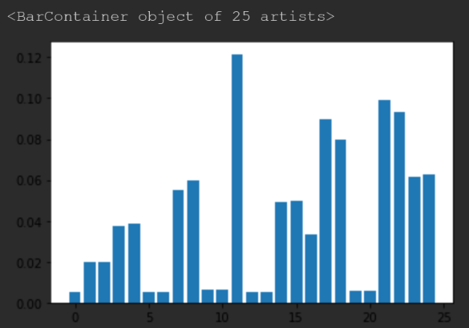
Automated Intracranial Artery Labeling using a Graph Neural Network and Hierarchical Refinement
Graph neural network (GNN) for node and edge probabilities
Frequency count : edge

Slide 12
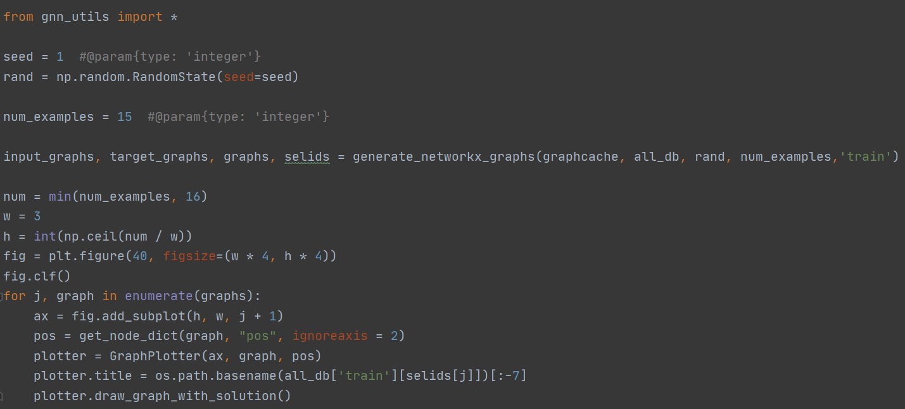
Automated Intracranial Artery Labeling using a Graph Neural Network and Hierarchical Refinement
Graph neural network (GNN) for node and edge probabilities
Visualize example graphs

Slide 13
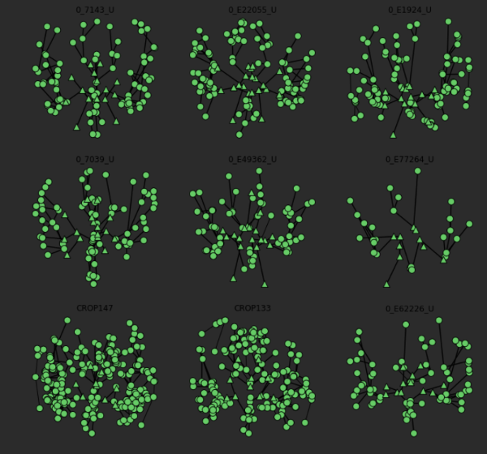
Automated Intracranial Artery Labeling using a Graph Neural Network and Hierarchical Refinement
Graph neural network (GNN) for node and edge probabilities
Visualize example graphs

Slide 14
Automated Intracranial Artery Labeling using a Graph Neural Network and Hierarchical Refinement
Graph neural network (GNN) for node and edge probabilities
Message passing GNN framework
proposed in [16, 21]
21. Gilmer, J., Schoenholz, S.S., Riley, P.F., Vinyals, O., Dahl, G.E.: Neural Message Passing for Quantum Chemistry. arXiv:1704.01212v2
Predict the types for each node and edge

Slide 15
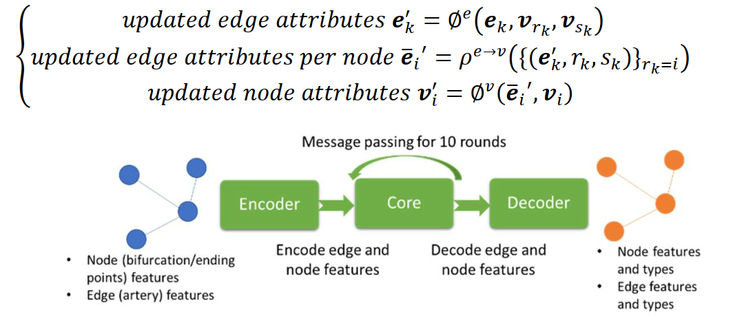
Automated Intracranial Artery Labeling using a Graph Neural Network and Hierarchical Refinement
Graph neural network (GNN) for node and edge probabilities
Message passing GNN framework
Input
a graph with node and edge features
Encoder
input features of edges and nodes in the graph are encoded to an embedding
Output
a graph with additional features for node and edge types

Slide 16
Automated Intracranial Artery Labeling using a Graph Neural Network and Hierarchical Refinement
Graph neural network (GNN) for node and edge probabilities
Training loss
combined weighted cross entropy losses
in both nodes and edges
Weighted loss
Inverse proportional to frequencies of the node and edge types
i.e. Frequent node/edge type → smaller weight on loss

Slide 17
Automated Intracranial Artery Labeling using a Graph Neural Network and Hierarchical Refinement
Graph neural network (GNN) for node and edge probabilities
Miscellaneous training setups
Batch size
32 graphs
Optimizer
Adam
Normalization
Positions of nodes from different datasets normalized based on the imaging resolution
Data augmentation
Random translation of positions (within 10%)

Slide 18
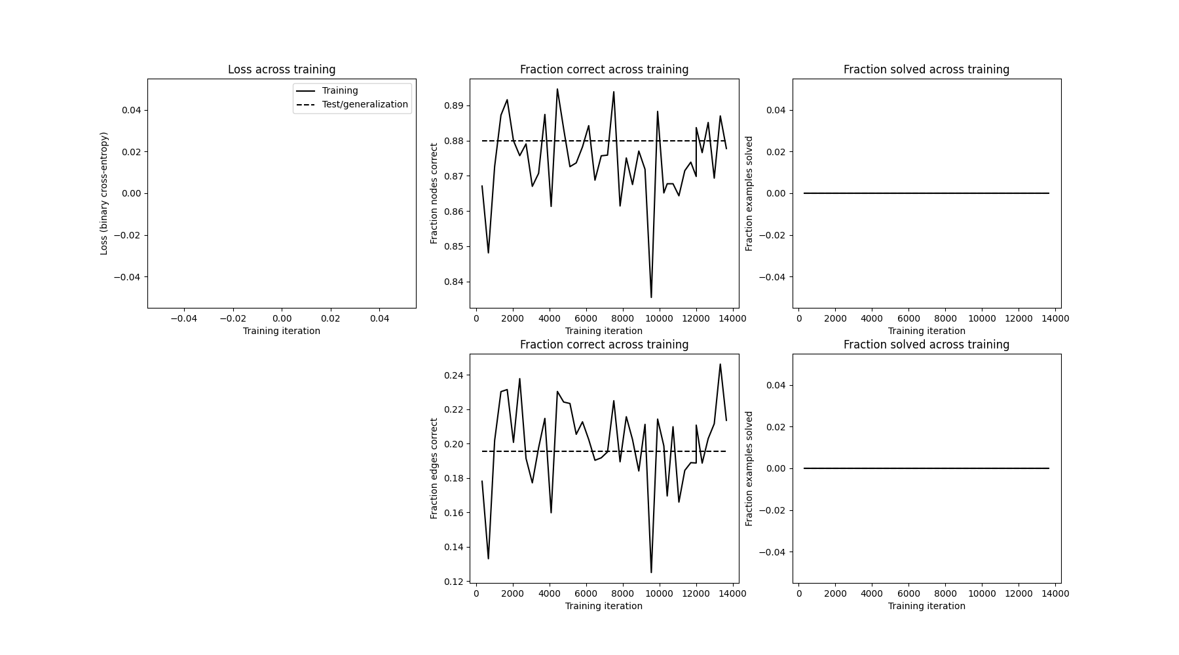
Automated Intracranial Artery Labeling using a Graph Neural Network and Hierarchical Refinement
Graph neural network (GNN) for node and edge probabilities
Loss

